Slide 1
Software Engineering
The economies of ALL developed nations are
dependent on software.
More and more systems are software-controlled.
Software Engineering is concerned with theories, methods and tools for professional software development.

Slide 2
What is Software Engineering?
Software engineering is an engineering discipline which is concerned with all aspects of software production.
Software engineers should
  adopt a systematic and organized approach to their work
  use appropriate tools and techniques

Slide 3
Characteristics of Software
Software is engineered, not manufactured.
Software doesn’t wear out, it declines, because of changes.
Software is complex

Slide 4
Where to use?
Software is used in many applications:
  system software
  application software
  engineering/scientific software
  Real-time, embedded software
  product-line software
  Web applications
  AI software

Slide 5
Software Engineering vs.
System Engineering
System engineering is concerned with all aspects of computer-based systems development including hardware, software and process engineering.
Software engineering is part of this process

Slide 6
What is Software Process?
When building a Product, it is important to go through a series of predictable steps, road map, that help you create a timely, and high-quality result.
The ROAD MAP that you follow is the Software Process.

Slide 7
Software Process
A set of activities whose goal is the development or evolution of software.
Generic activities in all software processes are:
  Specification - what the system should do and its development constraints
  Development - production of the software system
  Validation - checking that the software is what the customer wants
  Evolution - changing the software in response to changing demands

Slide 8
Process Characteristics
Prescribes all major process activities
Uses resources with constraints
Produces intermediate and final products
May be composed of sub-processes
Has entry and exit criteria
Is organized in a sequence
Has a set of guiding principles to explain process goals

Slide 9
Software Engineering Phases
Definition Phase – What
Development Phase – How
Maintenance Phase – Change

Slide 10
Definition (What???)
System or information engineering
Software project planning
Requirements analysis
Notes:
Addresses the questions of the:
- information to be processed
- functions desired
- performance desired
- interfaces
- validation criteria
- behavior of the system

Slide 11
Development (How???)
Software design
Code Generation
Software Testing
Notes:
- how the data is structured
- how functions are implemented as a software architecture
- how procedural details are to be implemented
- how interfaces are to be implemented
- how design will be translated to programming language
- how the above will be tested

Slide 12
Maintenance (Change)
Correction
Adaptation
Enhancement
Prevention
Notes:
1.Corrective maintenance corrects the defects found in the software.
2. Adaptive maintenance provides for changes needed to accommodate changes in the environment
3. Perfective maintenance extends software performance beyond original requirements
4. Preventive maintenance (software reengineering); changes that make programs easier to correct, adapt or enhance

Slide 13
Process in S.E
Software engineering encompasses a process, management techniques, technical methods, and the use of tools.
Major goals of software engineering are to :
  deliver project on time
  within budget
  Having required quality
  Satisfying the true needs of stakeholders

Slide 14
A Layered Technology
Software Engineering
tools
methods
process model
a “quality” focus

Slide 15
Variety of Software Processes
Software products are very varied...
Therefore, there is no standard process for all software engineering projects
BUT successful software development projects all need to address similar issues.
This creates a number of process steps that must be part of all software projects

Slide 16
Basic Process Steps in all Software Development
• Feasibility and planning
• Requirements
• System and program design
• Implementation and testing
• Deployment and release
• Operation and maintenance
Also known as Software Development Life Cycle (SDLC).

Slide 17
How Software changes?
Software must be adapted to meet the needs of new computing environments or technology.
Software must be enhanced to implement new business requirements.
Software must be extended to make it interoperable with other more modern systems or databases.
Software must be re-architected to make it feasible within a network environment.

Slide 18
Attributes of Good Software
The software should deliver the required functionality and performance to the user and should be maintainable, dependable and usable.
Maintainability
  Software must evolve to meet changing needs
Dependability
  Software must be trustworthy
Efficiency
  Software should not make wasteful use of system resources
Usability
  Software must be usable by the users for which it was designed

Slide 19
Software Engineering Process Models
Description of a real-world process that abstracts from irrelevant details.
Description which is used to guide or control the execution of a process.
Also known as:
  Software Development Life Cycle Models
  Process Models

Slide 20
Software Development Life Cycle Models
Software life cycle models describe phases of the software cycle and the order in which those phases are executed.
There are tons of models, and many companies adopt their own, but all have very similar patterns.

Slide 21
Process Model
A process model divides a process into phases or working areas.
Phase:
  Time interval in the execution of a process in which activities of a certain kind are executed.
Help the project manager and team to decide:
  What work should be done;
  In what sequence to perform the work.

Slide 22
General Life Cycle Model

Slide 23
General Life Cycle Model
Each phase produces deliverables required by the next phase in the life cycle.
Requirements are translated into design.
Code is produced during implementation that is driven by the design.
Testing verifies the deliverable of the implementation phase against requirements.

Slide 24
Requirements Phase
Business requirements are gathered in this phase.
Meetings with managers, stake holders and users are held in order to determine the requirements.
  Who is going to use the system?
  How will they use the system?
  What data should be input into the system?
  What data should be output by the system?

Slide 25
Requirements Phase contd…
Produce a nice big list of functionality that the system should provide, which describes functions the system should perform, business logic that processes data, what data is stored and used by the system, and how the user interface should work.
The overall result is the system as a whole and how it performs, not how it is actually going to do it.

Slide 26
Design Phase
The software system design is produced from the results of the requirements phase.
Architects have the ball in their court during this phase and this is the phase in which their focus lies.
This is where the details on how the system will work is produced.
Architecture, including hardware and software, communication, software design are all part of the deliverables of a design phase.

Slide 27
Implementation Phase
Code is produced from the deliverables of the design phase during implementation, and this is the longest phase of the software development life cycle.
For a developer, this is the main focus of the life cycle because this is where the code is produced.
Many tools exists (CASE tools) to actually automate the production of code using information gathered and produced during the design phase.

Slide 28
Testing Phase
During testing, the implementation is tested against the requirements to make sure that the product is actually solving the needs addressed and gathered during the requirements phase.
Unit tests and system tests are done during this phase.
Unit tests act on a specific component of the system, while system tests act on the system as a whole.

Slide 29
Process Models
Waterfall
Iterative Development
Incremental
Spiral
RUP
MDA
Agile Software Development

Slide 30
Waterfall Model
The most common and classic of life cycle models, also referred to as a linear-sequential life cycle model.
In a waterfall model, each phase must be completed in its entirety before the next phase can begin.
At the end of each phase, a review takes place to determine if the project is on the right path and whether or not to continue or discard the project.
Unlike general model, phases do not overlap in a waterfall model.

Slide 31
Waterfall Model
Phases
  Requirement Specification
  Software design
  Integration / implementation
  Testing / Validation
  Deployment / Installation
  maintenance
Note
In a waterfall model, each phase must be completed in its entirety before the next phase can begin.

Slide 32
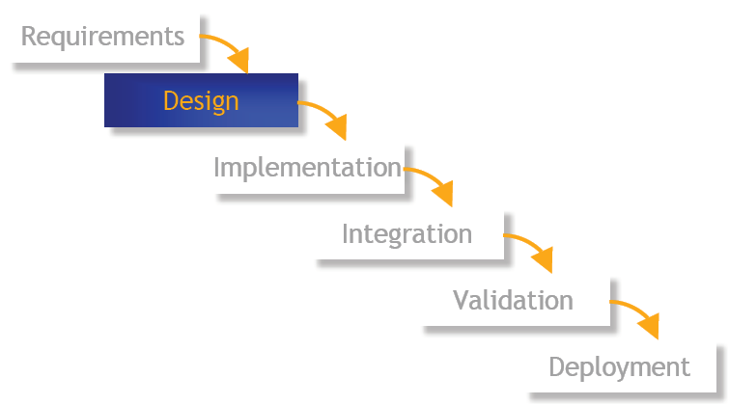
Waterfall Model

Slide 33
Prototyping Model
Prototyping, where an experimental system is developed as a basis for formulating the requirements may be used. This system is thrown away when the system specification has been agreed.

Slide 34
Prototyping Model
Used when
  Customer defines general objectives but doesn’t identify detailed requirements
  Developer may be unsure of algorithm efficiency, and other UI issues.
  Focus is on understanding the requirements
Customer and developer should meet and agree on using prototyping model.
Prototype is initial system, it is discarded and actual quality software is built.

Slide 35
Prototyping Model: Phases
Requirements Gathering
  Define overall objectives and identify known requirements
Quick Design
  Representation of inputs, outputs
Prototype Construction
  “First” system built
Prototype Evaluation
  By customer, to refine the requirements
Iterations
  To satisfy customer requirements

Slide 36
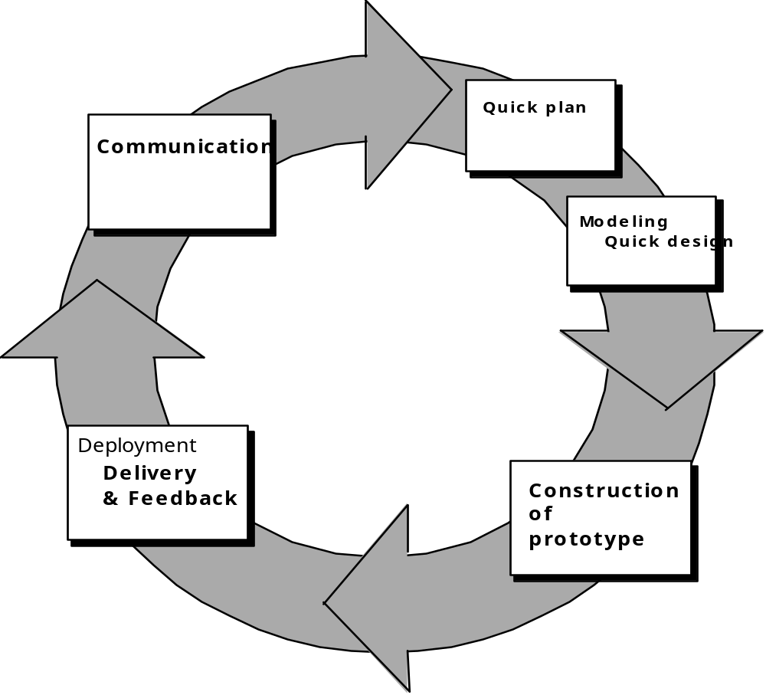
Prototyping Model

Slide 37
Iterative Development
The problems with Waterfall model demanded a more faster and flexible development method.
With Iterative development, the project is divided into small parts.
This allows the development team to demonstrate results earlier on in the process and obtain valuable feedback from system users.
Often, each iteration is actually a mini-Waterfall process with the feedback from one phase providing vital information for the design of the next phase.

Slide 38
Iterative Development
Domain engineering:
  Get acquainted with domain of discourse
Requirements
Build baseline system:
  Build minimal useful system
Iterate:
  Extend with well-defined functionality
Roll-out and documentation

Slide 39
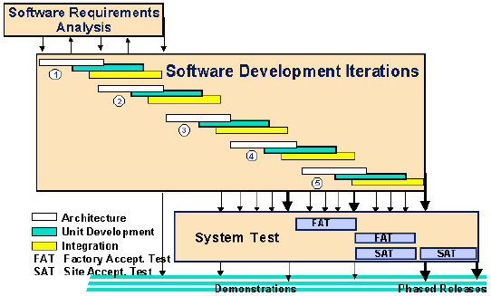
Iterative Model

Slide 40
RAD (Rapid Application Development) Model
Extremely short development life cycle
“High-speed” adaptation of Waterfall
Component based construction
If requirements are well-understood, fully functional system can be built in limited time.
Concurrent process of specification, design and implementation.

Slide 41
RAD Model
Multiple software teams work in parallel on different system functions.
Reusable software components can be constructed.
Results in a significantly short development time.

Slide 42
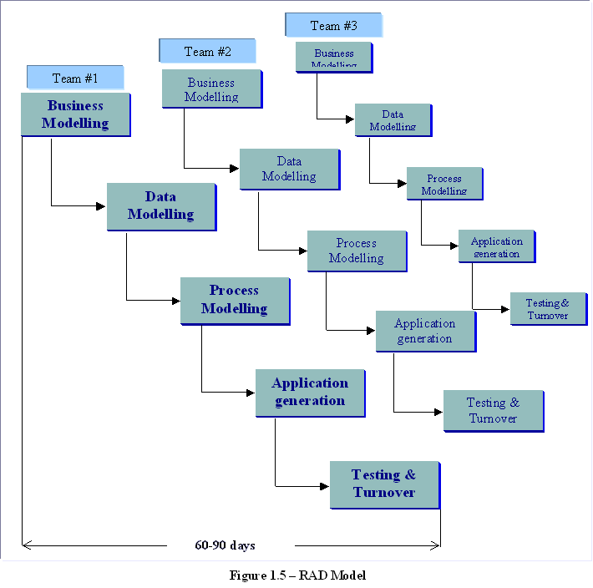
RAD Teams

Slide 43
Spiral Model
Combination of iterative nature of Prototyping and controlled aspects of Waterfall.
Provides the potential for rapid development of incremental versions of software
It is a cyclic approach for incrementally growing a system’s degree of definition and implementation while decreasing its degree of risk.
Software is developed in a series of evolutionary releases.
In early iterations, release might be paper model or prototype.
During later iterations, increasingly more complete versions are produced.

Slide 44
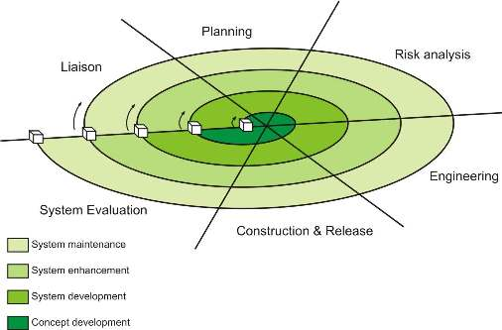

Slide 45
Spiral Model
Each loop in the spiral shows a phase of the SW process.
Each loop will be split into few sections, the task regions.
Each region conducts a set of work tasks, the task set.

Slide 46
Unified Process (UP)
The Unified Software Development Process or Unified Process is a popular iterative and incremental software development process framework.
The Unified Process is
  Iterative and incremental
  Use case driven
  Architecture-centric
  Risk-focussed

Slide 47
UP Phases
Inception:
  Business rationale, scope, identify risks, estimates
Elaboration:
  Requirements, high-level analysis and design of baseline architecture, construction plan, risk management.
Construction:
  Implement system features
    iteration 1: use cases A,B,C implemented
    iteration 2: use cases D,E implemented
    ...
Transition:
  Deployment, Beta testing, performance tuning, user training.

Slide 48
RUP (Rational Unified Process)
The best-known and extensively documented refinement of the Unified Process is the Rational Unified Process or RUP.
IBM Rational Unified Process (RUP) is a comprehensive process framework that provides proven best practices for software and systems delivery and implementation and effective project management.

Slide 49
RUP
It provides a disciplined approach to assigning tasks and responsibilities within a development organization.
Its goal is to ensure the production of high-quality software that meets the needs of its end-users, within a predictable schedule and budget.
RUP enhances team productivity, by providing every team member with easy access to a knowledge base with guidelines, templates and tool mentors for all critical development activities.
By having all team members accessing the same knowledge base, no matter if you work with requirements, design, test, project management, or configuration management, we ensure that all team members share a common language, process and view of how to develop software.

Slide 50
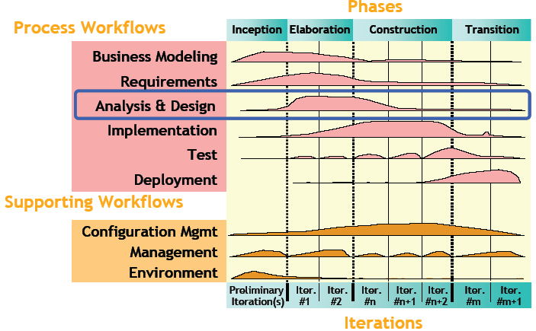

Slide 51
Features
The RUP activities create and maintain models.
Rather than focusing on the production of large amount of paper documents, the Unified Process emphasizes the development and maintenance of models—semantically rich representations of the software system under development.
The Rational Unified Process is supported by tools, which automate large parts of the process.
They are used to create and maintain the various artifacts—models in particular—of the software engineering process: visual modeling, programming, testing, etc.

